Slide 1
ART & DESIGN

Slide 2
Students Say-
The thing I like best about art is you feel really proud once you have completed a piece of work.
I would advise pupils to opt for art because the lessons are fun and you combine this with working hard.

Slide 3
Students Say-
The thing I like best about art is the fact that there is no right or wrong as everything is your own creative interpretation
I would advise pupils to opt for art because if you have lots of academic subjects it’s a nice way to relax in a creative practical way.

Slide 4
Students Say-
The thing I like best about art is you can produce work that you are interested in and you don’t do the same as everyone else
I would advise pupils to opt for art because the exam is all practical and different from most subjects

Slide 5
WHY PICK ART?
IF YOU ARE.......
CREATIVE
HARD -WORKING
INDEPENDENT
TEAM PLAYER
IMAGINATIVE

Slide 6
Are there any exams? GCSE
60% Portfolio
A selection of your strongest pieces of work will be presented as your portfolio
40% Examination
Questions set be the exam board covering a range of specialist areas

Slide 7
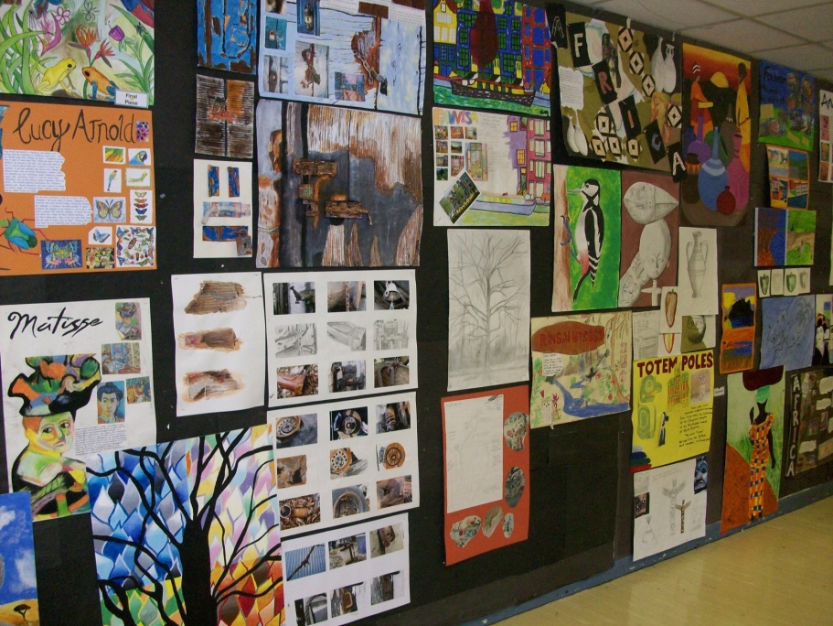
GCSE ART AND DESIGN
Take up one option block
Drawing
Painting
Printing
Mixed Media
Photography
Sketchbook work
3D

Slide 8
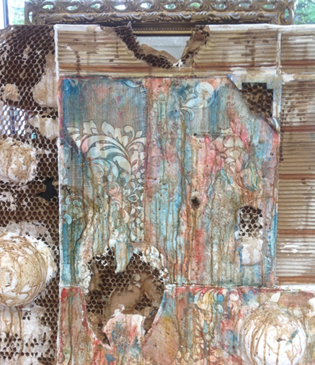
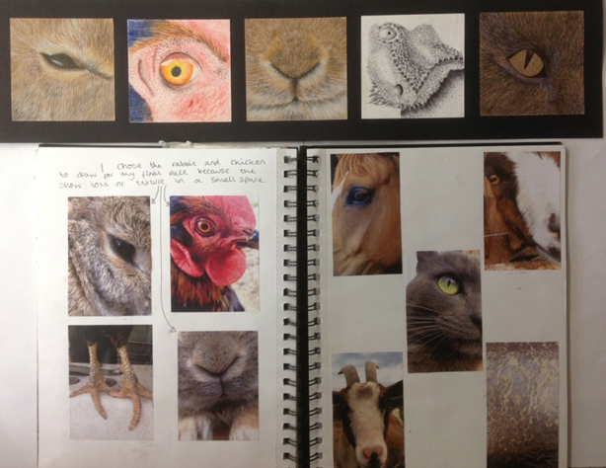
Assessment Objectives
A01 | A02 | A03 | A04
Develop ideas through investigations, demonstrating critical understanding of sources | Refine work by exploring ideas, selecting and experimenting with appropriate media, materials, techniques and processes. | Record ideas, observations and insights relevant to intentions as work progresses. Through drawing and annotation | Present a personal and meaningful response that realises intentions and demonstrates understanding of visual language.

Slide 9
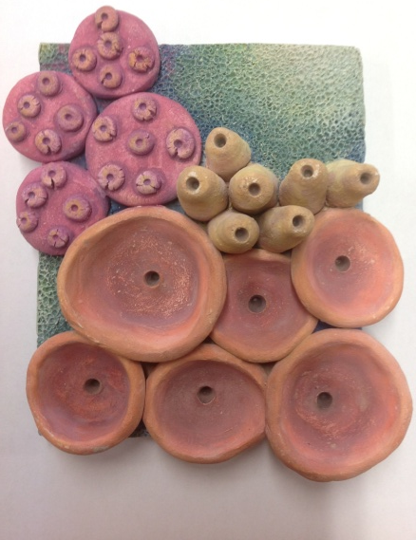
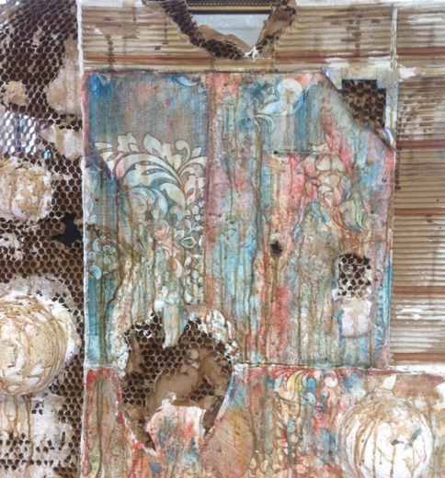
Try these for starters:
•• Fashion design
•• Graphic design
•• Theatre designer
•• Animator
•• Video game designer
•• Illustrator
•• Museum curator
•• Photographer
•• Architecture
•• Product design
•• Textiles design
•• Advertising
•• Publishing
•• Interior design
•• Fashion and media journalism
•• Hair and make-up design
•• Retail design
•• Exhibition design
•• Jewellery design
•• Artist
•• Visual media
•• Teaching

Slide 10
Course Expectations
You would be completing work to GCSE
standard.
You will be expected to -
Have a behaviour and attitude that enables yourself and others to learn at all times.
Complete all homework to the set deadline.
Come prepared to each lesson with equipment and planners.

Slide 11
Misconceptions
Art is easy
It takes time, skill and dedication
You will be expected to work hard throughout all lessons
No homework
You will get homework every week which is part of your coursework

