Slide 1
Further Mathematics
Options 23-24

Slide 2
Maths at Byrchall
At present, you will have 4 maths lessons per week.
Further Maths is not an extra set of Maths lessons to help you with your Maths
However, your Regular Maths lessons will compliment your Further Maths lessons.

Slide 3
Why study Further Maths?
Extend and deepen your knowledge
Explore challenging mathematical concepts
Develop your higher level problem solving skills
Make the transition from GCSE to A Level easier

Slide 4
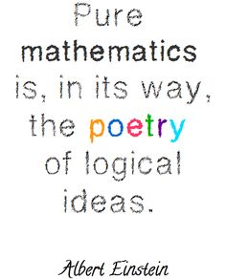
Who is it for?
Those wishing to take the subject further and possibly study A Level.
Those with a love of learning maths and a natural mathematical ability
Not sure if it is right for you, speak to your Maths Teacher.

Slide 5
Pathways/Examinations
There will be three key elements to you Further Maths Journey.
GCCE Statistics (counts towards College applications)
Algebra Award (level 3)
FSMQ in Mathematics
All examined in year 11, with Stats. and FSMQ in summer & Algebra Level 3 in January of year 11.

Slide 6
GCSE Statistics (L2)
Topics are clearly and logically structured and include:
Understanding the importance of careful planning, a clear strategy for collecting, recording and processing data in order to address an identified question or hypothesis.
Generating data visualisation and understanding the maths involved.
Notes:
Statistics is about making decisions when there is uncertainty. Perhaps one of the most versatile areas of maths, it gives students the skills to collect, analyse, interpret and present data.
It complements subjects such as GCSE Biology, Psychology, Geography, Business and Economics, and opens the door to a variety of careers – from weather forecasting to the biological sciences.

Slide 7
GCSE Statistics (L2)
Content and assessment overview The Pearson Edexcel Level 1/Level 2 GCSE (9–1) in Statistics consists of two externally-examined papers.
Students must complete all assessment in May/June in any single year, and students can only be entered for either Foundation tier or Higher tier.

Slide 8
GCSE Statistics (L2)

Slide 9
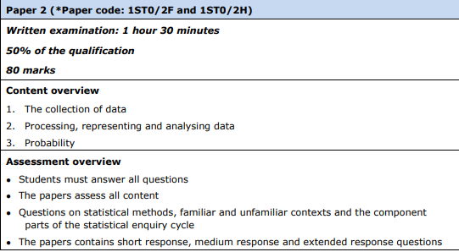
GCSE Statistics (L2)

Slide 10
Algebra Award (L3)
Develop a thorough knowledge and understanding of concepts in algebra and a sound foundation of mathematical techniques
Acquire confidence in their mathematical skills to move into further study in the subject or related areas
Enjoy using mathematics and become confident when using mathematics

Slide 11
Algebra Award (L3)

Slide 12
OCR Free Standing (L3)
The Advanced FSMQ, Additional Mathematics, is worth UCAS points for university admissions, and introduces students to the power and elegance of advanced mathematics.

Slide 13
Content to Research
The Advanced FSMQ, topics include:
Calculus (Differentiation / Integration)
Kinematics
Logarithms
Equations of Circles
Equations of Tangents and Normals to Curves.
Plus many more!

